Slide 1
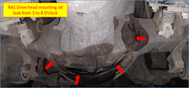
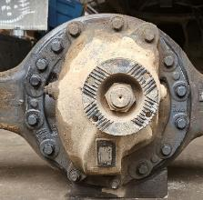
Drive Head Joint leak in 18TG axle casing with 15i 15 bolt Meritor
Complaint / Problem details |  | 18TG Axle casing with MT15i – 15bolt – Drive head joint leak |  |  |  | Issue status | RL3
 |  |  |  |  |  | Issue grade | 3
Model |  | 6x4T, 8x4T & 10x4T – BGS Tipper | Failure Kms | 11 – 2755 Hrs (73% <1000 Hrs) |  | Data as on | Aug’23
Mfg plant |  | H2 & PNR | No of cases | 73 (Labour claims) |  | Resp | Meritor
Observation/ Root cause | Observation / Analysis 4 failures informed for joint study along with Meritor on MT15i 18TG axle casing for Drive head joint leak Following are the observations Failures are reported in both RA1 & RA2 axle Application study carried out and found vehicle is operating as per spec. In all 4 cases, Oil leak & bolt loosening observed. Bolt length found as per spec. Earlier action on Drive head Joint leak failures in 16TG axle Based on analysis by PD, Presence of Dowel is leading to Bolt loose in MT149.7 / MT15i – 14 bolt. Action: MT15i – 15 bolt version (without dowel) to address bolt loosening implemented in all BGS tipper. C: Nov’22 Now after cut off cases reported. Meritor has identified below potential causes for Joint leak based on initial analysis DH to Housing mounting bolt Loosen. Surface roughness to be improved. Current value is 0.4 to 0.6 Ra against spec of Max. 6.6 Ra Sealant Entrapment inside the carrier hole |  | Photos / Illustration |  | Illustration
 |  |  |  |  | v
Action | Surface roughness on Ring is increased. Current Ra-0.4 to 0.6 is increase to Ra- 2.4 to 3.6. C: Aug’23 RA1 Carrier bolt repositioning to increase its wall thickness. CR-0040631 released. CA release under progress In addition to the above, Meritor is exploring following options and will provide feedback. T: Sep’23 Mounting bolt change from coarse pitch to fine pitch Feasibility for blind hole in place of thru hole
Notes:
Content Slide

Slide 2
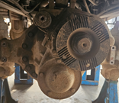
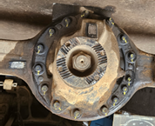
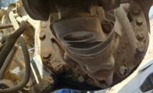
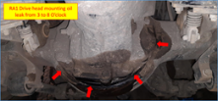
MT15i 18TG – DH joint leak in BGS Tipper Failure summary
4 cases JI done
Case | 1 | 2 | 3 | 4
Issue | Drive head joint leak - RA2 | Drive head joint leak - RA1 | Drive head joint leak - RA1 & RA2 | Drive head joint leak - RA1 & RA2
Axle model | MT15i | MT15i | MT15i | MT15i
Chassis No | MB1JJVLD7NPPU3677 | MB1JJLHD8NRBD8275 | MB1JJLHD3NRCC1600 | MB1JJLHD6PRNE8461
Model | 3525 BGS Tipper | 3525 BGS Tipper | 3525 BGS Tipper | 3525 BGS Tipper
RAR | 5.83 | 5.83 | 5.83 | 5.57
DOS | 31-Dec-22 | 27-Dec-22 | 31-Oct-22 | 17-Feb-23
DOF | 13-Jun-23 | 7-Jul-23 | 7-Jul-23 | 18-Jul-23
Kms / Hrs reading | 1922 | 1363 | 1173 | 1669
Unit | Hrs | Hrs | Hrs | Hrs
DH / Axle S.No | RA2 - MA22K091152 | RA1 - MA22K092148 | RA1 - MA22J076710 RA2 - MA22I070659 | RA1 - MA22L099450 RA2 - MA22L106547
Location | Rajahmundry | Chennai | Chennai | Chennai
Leakage location | RA2 – 5 O’ clock to 8 O’ clock | RA1 – 7 O’ clock to 9 O’ clock | RA1 – 3 O’ clock RA2 – 2 O’ clock to 11 O’ clock | RA1 – 3 O’ clock to 7 O’ clock RA2 – 12 O’ clock
DH mounting bolts | Bolt torque not checked | Bolt torque found ok | RA1 – 3 O’ clock & 7 O’ clock bolts RA2 – 2 O’ clock to 11 O’ clock bolts | RA1 – 3 O’ clock bolt RA2 – 12 O’ clock not checked
Part details | Sealant applied and Torque done | Sealant applied and Torque done | Part under dispatch to Meritor for analysis from Dealer | Sealant applied and Torque done
Photograph
Notes:
Content Slide

Slide 3
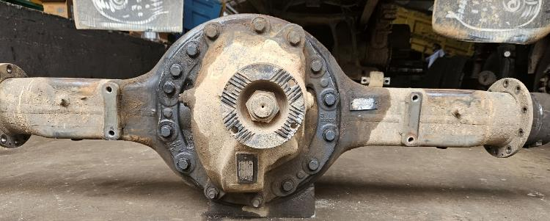
Case 3 – MT15i 18TG DH joint leak in 3525 BGS Tipper Field JI carried out at Poonamalle
15
RA2
14
1
13
2
Leak location:
RA1 – 3 O’ clock
RA2 – 2 O’ clock to 11 O’ clock
12
3
11
4
5
10
6
9
8
7
Drive head mounting bolt torque drawing spec 266 to 355 NM
Bolt ID | 1 | 2 | 3 | 4 | 5 | 6 | 7 | 8 | 9 | 10 | 11 | 12 | 13 | 14 | 15
Loosening torque (RA1), Nm | NC | NC | 140 | 330 | 330 | 330 | 260 | 300 | 300 | 355 | 300 | 330 | 330 | NC | NC
Loosening torque (RA2), Nm | 300 | 75 | 75 | 75 | 75 | 75 | 200 | 300 | 300 | 150 | 75 | 75 | 75 | 150 | 250

Slide 4
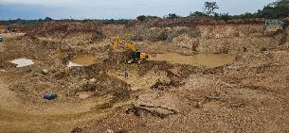
Application study
Project site
Type of load : Sand gravel
Operating route : Irungattukottai to kanakammachathram (120 Kms)
Lead distance : 8 Kms
Customer name : A.J Poul earth movers
Road condition : 97% highway / good road (116 Kms), 3 % Kutcha / off road (4 Kms)
Operating load : Onward – Sand gravel, Return – Empty
Vehicle operation : Single Shift – 8 am to 8 pm
Operating speed (with load) : ~50-60 Kmph on highway, ~15-20 Kmph on Kutcha road
Operating speed (Empty) : ~60 Kmph on highway, ~15-20 Kmph on Kutcha road
GVW : 62T (Based on customer voice)

Slide 5
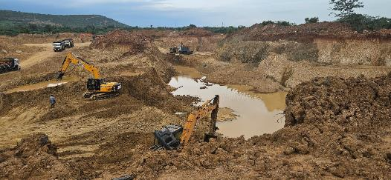
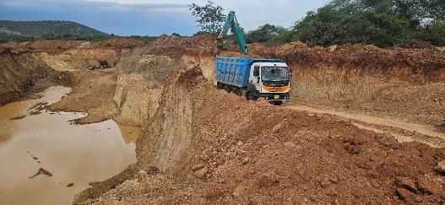
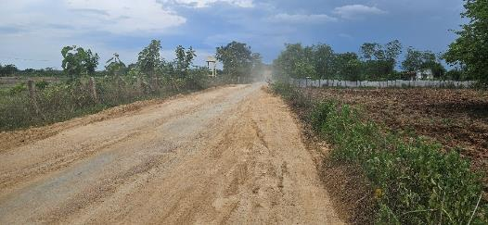
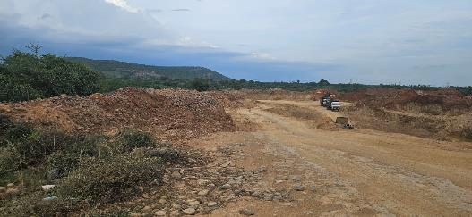
Application study
60 KMS
Loading point
Unloading point

Slide 6
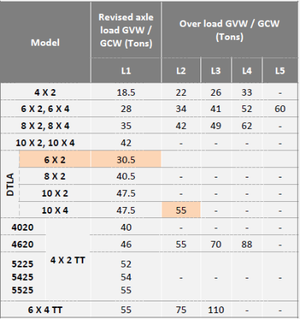
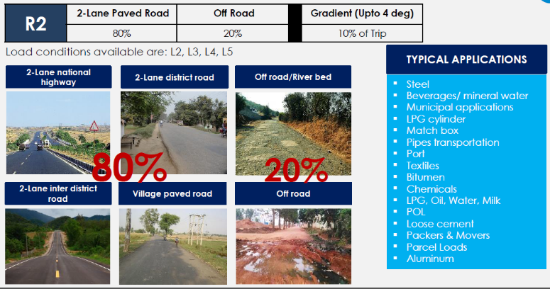
Application study
 | Spec | Actual
Load | GVW: 62T | GVW: 41 - 42T
Road | 20% off road permissible | 97% Highway, 3% Kutcha / off road
LR | L4R2 | L4R2
Vehicle operating as L4R2

Slide 7
MT15i 18TG DH joint leak Data analysis
Model | Labour |  | Material |  | Total
 | No of claims | Exp | No of claims | Exp | No of claims | Exp
2820 BGS Tipper | 2 | 2,331 | 2 | 3,486 | 4 | 5,817
2825 BGS Tipper | 4 | 4,924 | 3 | 11,418 | 7 | 16,343
3520 BGS Tipper | 1 | 1,776 |  |  | 1 | 1,776
3525 BGS Tipper | 15 | 20,862 | 11 | 33,037 | 26 | 53,899
4825 BGS Tipper | 3 | 2,481 | 7 | 23,037 | 10 | 25,518
Grand Total | 25 | 32,374 | 23 | 70,978 | 48 | 1,03,352
No of incidences - 16
No of incidences - 23

Slide 8
MT15i 18TG DH joint leak Data analysis
Region | District | 2820 | 2825 | 3525TS | 4825DTLA | Total
TAMIL NADU (15 Cases) | Tiruvallur |  |  | 6 |  | 6
 | Pudukkottai |  | 2 |  |  | 2
 | Kanchipuram |  |  | 2 |  | 2
 | Coimbatore |  |  |  | 1 | 1
 | Salem |  | 1 |  |  | 1
 | Tirunelveli |  |  | 1 |  | 1
 | Ariyalur |  |  | 1 |  | 1
 | Krishnagiri |  |  | 1 |  | 1
WEST BENGAL (7 Cases) | Birbhum |  |  |  | 3 | 3
 | North 24 Parganas |  |  |  | 3 | 3
 | West Midnapore |  |  |  | 1 | 1
MADHYA PRADESH (6 Cases) | Sagar |  |  | 3 |  | 3
 | Dewas |  |  | 2 |  | 2
 | Raisen |  | 1 |  |  | 1
ANDHRA PRADESH (6 Cases) | Kurnool |  |  | 3 |  | 3
 | East Godavari |  |  | 2 |  | 2
 | West Godavari | 1 |  |  |  | 1
ODISHA (4 Cases) | Sundaragrh |  |  |  | 1 | 1
 | Khorda | 1 |  |  |  | 1
 | Jharsuguda |  |  |  | 1 | 1
 | KENDUJHAR |  |  |  | 1 | 1
GUJARAT (4 Cases) | VALSAD |  |  |  | 1 | 1
 | Surat |  |  |  | 1 | 1
 | Bharuch |  |  | 1 |  | 1
 | Navasari |  |  |  | 1 | 1
MAHARASHTRA (4 Cases) | Nandurbar |  |  |  | 2 | 2
 | Palghar |  |  | 1 |  | 1
 | Nagpur |  |  |  | 1 | 1
JHARKHAND (3 Cases) | Jharidih |  |  | 3 |  | 3
ASSAM (3 Cases) | Kamrup |  | 3 |  |  | 3
KARNATAKA (2 Cases) | Bengaluru |  |  | 1 |  | 1
 | Bangalore Rural |  |  | 1 |  | 1
PONDICHERRY (1) | Pondicherry |  |  | 1 |  | 1
CHHATTISGARH (1) | Janjgir-champa | 1 |  |  |  | 1
RAJASTHAN (1) | Ajmer |  |  |  | 1 | 1
KERALA (1) | Alappuzha |  |  |  | 1 | 1
73%
73%

Slide 9

Notes:
End slide

